Slide 1

Deep Music: Understanding, Generation, and Interaction
Presenter: Zijian Zhao
Ph.D. Student in Civil Engineering (Scientific Computation)
Department of Civil and Environmental Engineering
The Hong Kong University of Science and Technology

Slide 2








Part I: Background

Slide 3
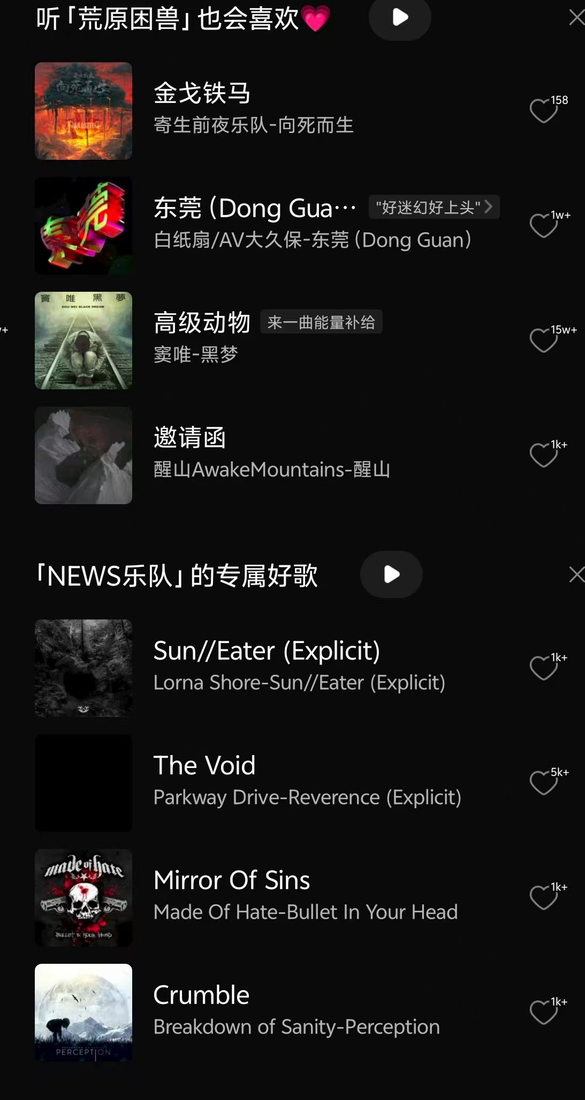
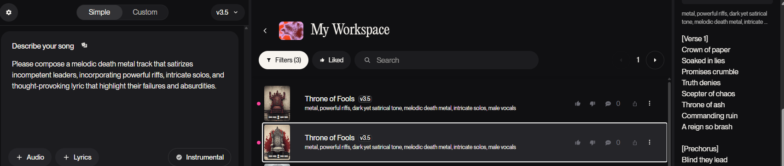
Background: Music Information Retrieval (MIR)
What is MIR?
MIR is the study and application of techniques to extract, analyze, and manage information from music. It encompasses audio analysis, music classification, recommendation systems, and content-based retrieval, aiming to improve how we search for and interact with music. (in short: computer + music)
Applications of MIR:
Music Recommendation System
Music Generation Models
Music and Lycris Analysis, Music Education, ......
SUNO Music Generator
QQ Music Recommender

Slide 4
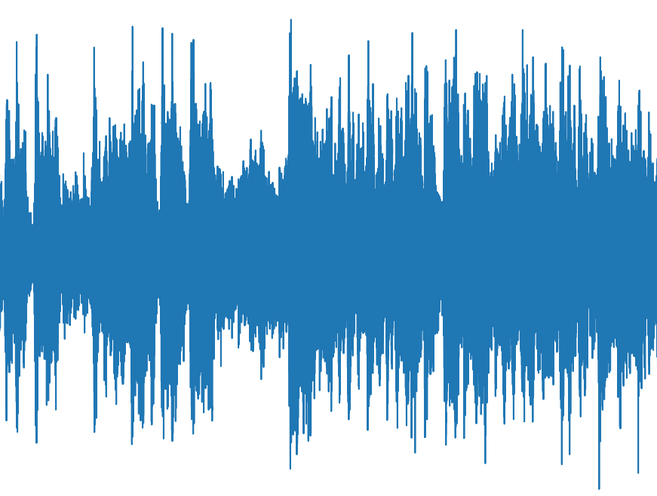
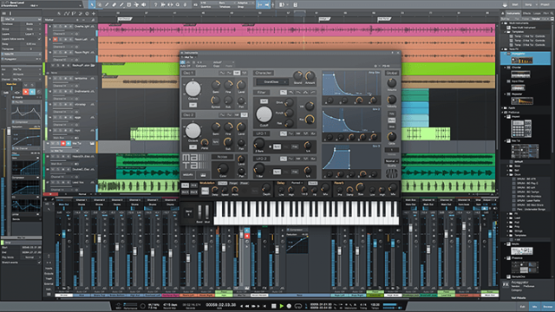
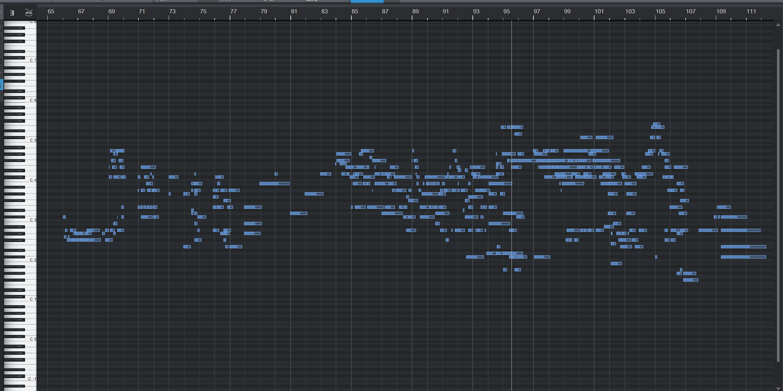
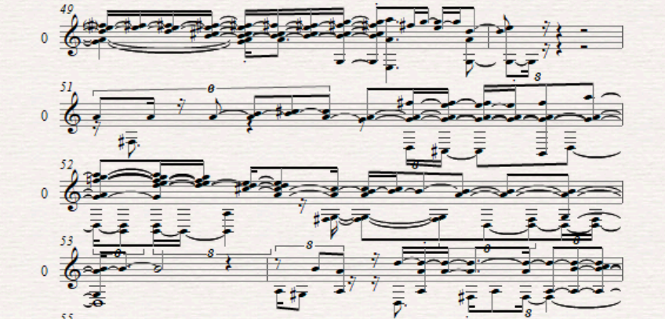
Background: Music Representation in MIR
Audio Music
Original File (for computer programs):
Mp3
Wav
Representation Manners (for neural networks):
Tokenization
Continous Embedding
Symbolic Music
Original File:
MIDI
MusicXML
ABC
Representation Manners:
CP [1]
REMI [2]
Octuple [3]
Audio Music
Symbolic Music
Notes:
[1] Hsiao W Y, Liu J Y, Yeh Y C, et al. Compound word transformer: Learning to compose full-song music over dynamic directed hypergraphs[C]//Proceedings of the AAAI Conference on Artificial Intelligence. 2021, 35(1): 178-186.
[2] Huang Y S, Yang Y H. Pop music transformer: Beat-based modeling and generation of expressive pop piano compositions[C]//Proceedings of the 28th ACM international conference on multimedia. 2020: 1180-1188.
[3] Zeng M, Tan X, Wang R, et al. Musicbert: Symbolic music understanding with large-scale pre-training[J]. arXiv preprint arXiv:2106.05630, 2021.

Slide 5
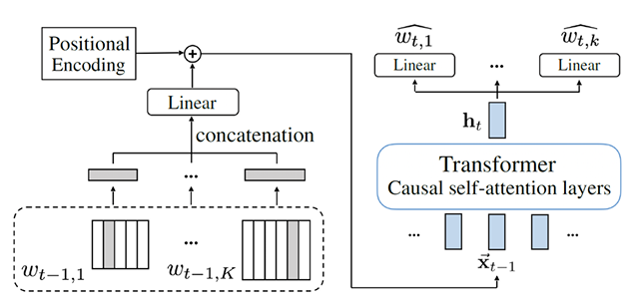
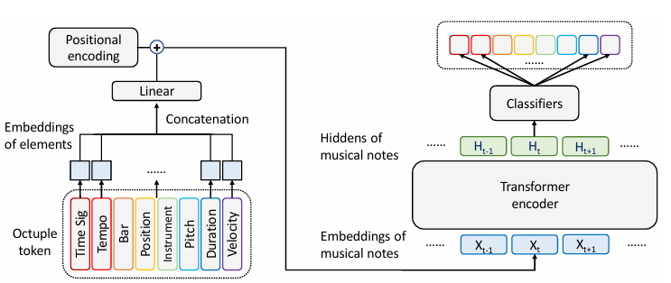
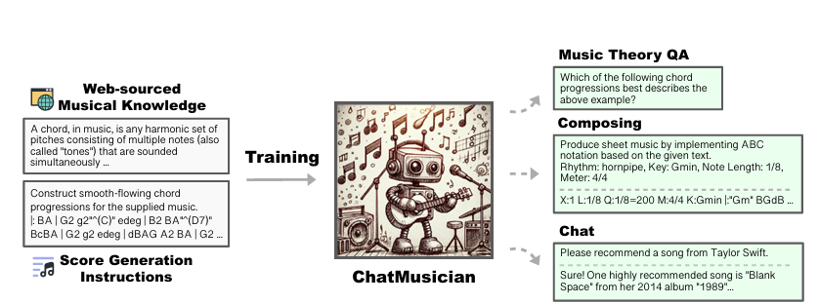
Background: Natural Language Models in MIR
-- “Music is the universal language of mankind.”
Representative MIR Models based on Nautral Language Models
Early Stage
Music Transformer [4]
POP Music Transformer [2]
CP Transformer [1]
Pre-training Period
MidiBERT [5]
MusicBERT [3][6]
MuseBERT [7]
MERT [8]
LLM Era
ChatMusician [9]
YuE [10]
WavJourney [11]
CP Transformer
MusicBERT (symbolic)
ChatMusician
Notes:
[4] Huang C Z A, Vaswani A, Uszkoreit J, et al. Music transformer[J]. arXiv preprint arXiv:1809.04281, 2018.
[5] Chou Y H, Chen I C, Chang C J, et al. Midibert-piano: Large-scale pre-training for symbolic music understanding[J]. CoRR, 2021.
[6] Zhu H, Niu Y, Fu D, et al. MusicBERT: A self-supervised learning of music representation[C]//Proceedings of the 29th ACM International Conference on Multimedia. 2021: 3955-3963.
[7] Wang Z, Xia G. MuseBERT: Pre-training Music Representation for Music Understanding and Controllable Generation[C]//ISMIR. 2021: 722-729.
[8] Li Y, Yuan R, Zhang G, et al. Mert: Acoustic music understanding model with large-scale self-supervised training[J]. arXiv preprint arXiv:2306.00107, 2023.
[9] Yuan R, Lin H, Wang Y, et al. Chatmusician: Understanding and generating music intrinsically with llm[J]. arXiv preprint arXiv:2402.16153, 2024.
[10] Yuan R, Lin H, Guo S, et al. Yue: Scaling open foundation models for long-form music generation[J]. arXiv preprint arXiv:2503.08638, 2025.
[11] Liu X, Zhu Z, Liu H, et al. Wavjourney: Compositional audio creation with large language models[J]. IEEE Transactions on Audio, Speech and Language Processing, 2025.

Slide 6
Research Questions
Music Understanding
Sequence-Level Tasks
composer prediction
emotion classification
Token-Level Tasks
melody extraction
velocity prediction
Music Generation
Music Continuation
Multi-Modal Music Interaction
X to Music
Music to X

Slide 7

Part II: Symbolicy Music Understanding
Adversarial-MidiBERT
[1] Zijian Zhao*, "Let Network Decide What to Learn: Symbolic Music Understanding Model Based on Large-scale Adversarial Pre-training", 2025 ACM International Conference on Multimedia Retrieval (ICMR), 2025

Slide 8
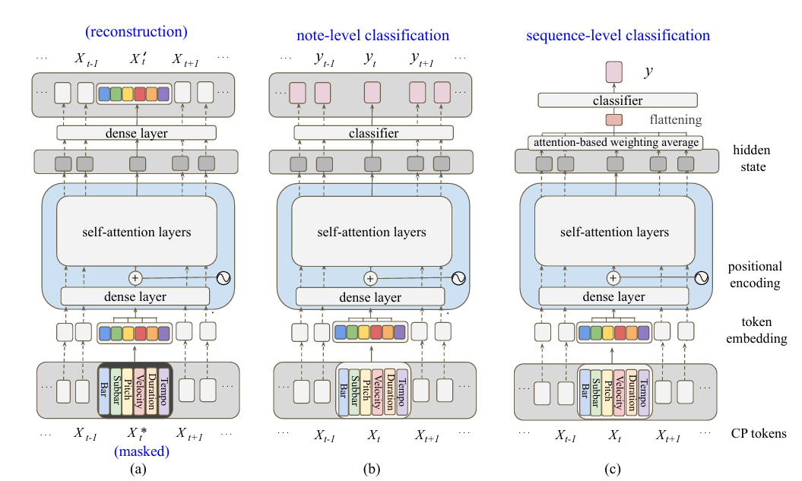
Preliminary: MidiBERT
Pre-training
Mask Language Model (MLM)
Fine-tuning
train specific classification heads

Slide 9
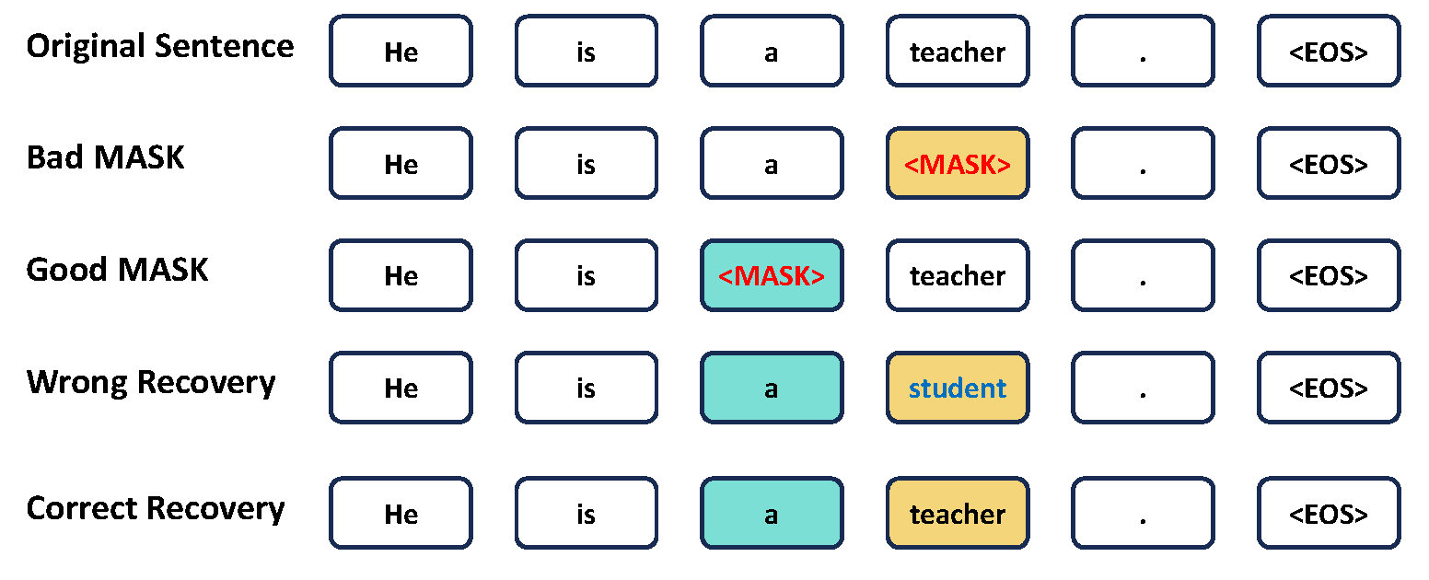

Problem of Conventional MLM: BIAS
Reason of Bias
Not all tokens can be recovered from context.
1+1=_.
(A) 2 (B) 3
train
(A)
Potential Result:
overfit to training set
1+1=_.
Take natural language for an example.
test
We aim for the model to learn common musical structures, relationships, and regularities—such as basic modes, riff patterns, and modulation techniques—rather than developing habits specific to particular composers.
(A)

Slide 10
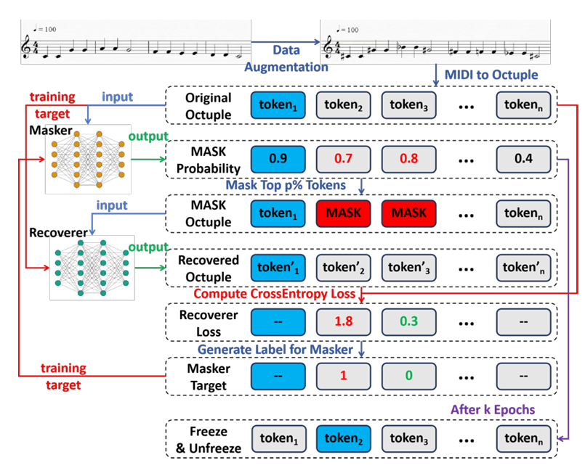
Workflow
Recoverer
Attempts to recover masked tokens.
Masker
Aims to mask tokens that are challenging for the Recoverer to accurately recover.
Freeze Mechanism
Regularly freezes tokens with the highest probability of being selected by the Masker.
Intuition: The most challenging tokens to recover are context-free tokens. The Recoverer can only infer these tokens based on the distribution of the training set.

Slide 11
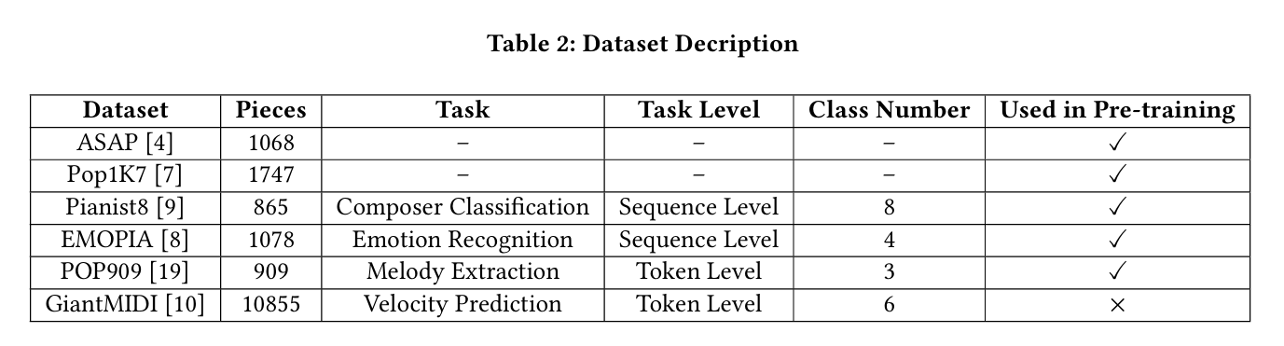
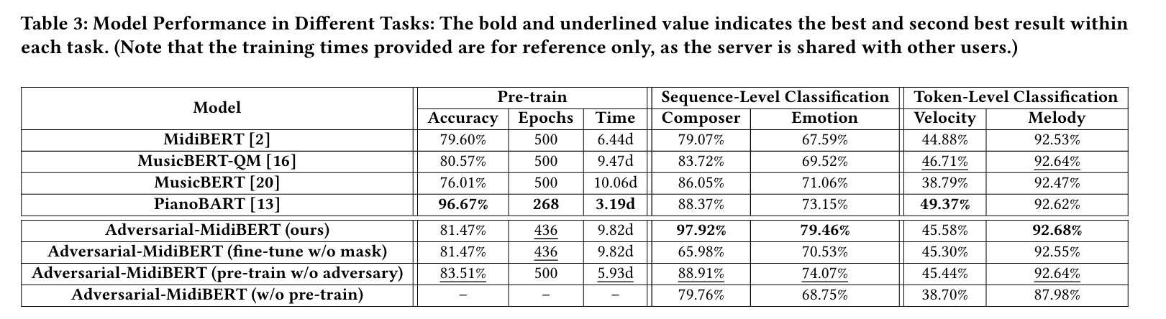
Experiment

Slide 12
Part III: Symbolicy Music Generation
PianoBART
[2] Xiao Liang, Zijian Zhao, Weichao Zeng, Yutong He, Fupeng He, Yiyi Wang, Chengying Gao*, "PianoBART: Symbolic Piano Music Understanding and Generating with Large-Scale Pre-Training", 2024 IEEE Conference on Multimedia Expo (ICME), 2024

Slide 13
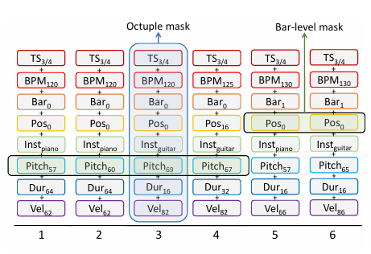
Preliminary: MusicBERT
Otuple Music Representation Manner
Time signature
Tempo
Bar
Position
Instrument
Pitch
Duration
Velocity

Slide 14
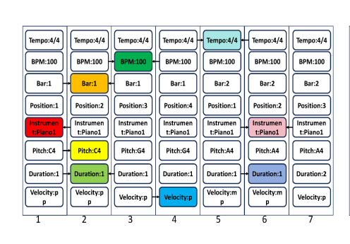
Problem of Music MLM: INFORMATION LEAKAGE
Finding
There are many repetitive attributes in successive tokens of music.
Problem
In vanilla MLM, the model can simply copy the missing token from neighboring tokens. With this strategy, even if the model learns nothing, it can still achieve relatively high accuracy.

Slide 15
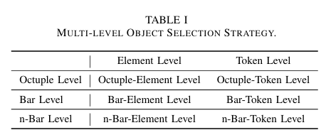
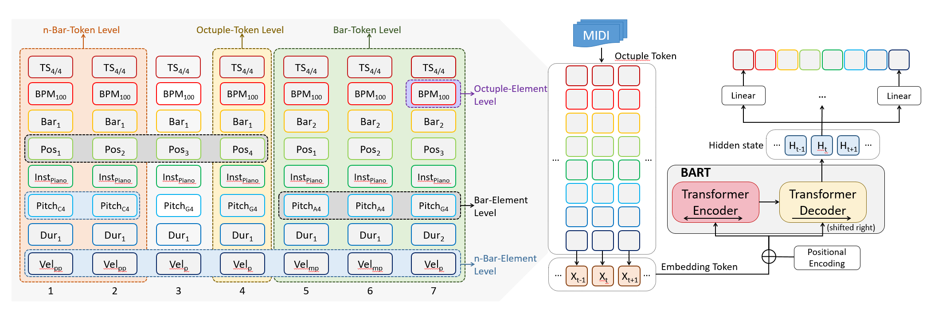
Model Structure
Pre-training Tasks of BART
Token Masking (MLM)
Token Deletion
Text Infilling
Sentence Permutation
Document Rotation

Slide 16
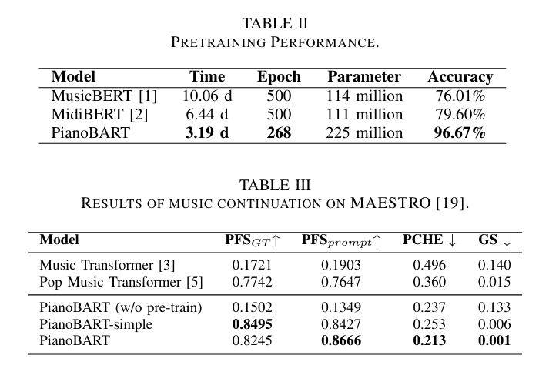
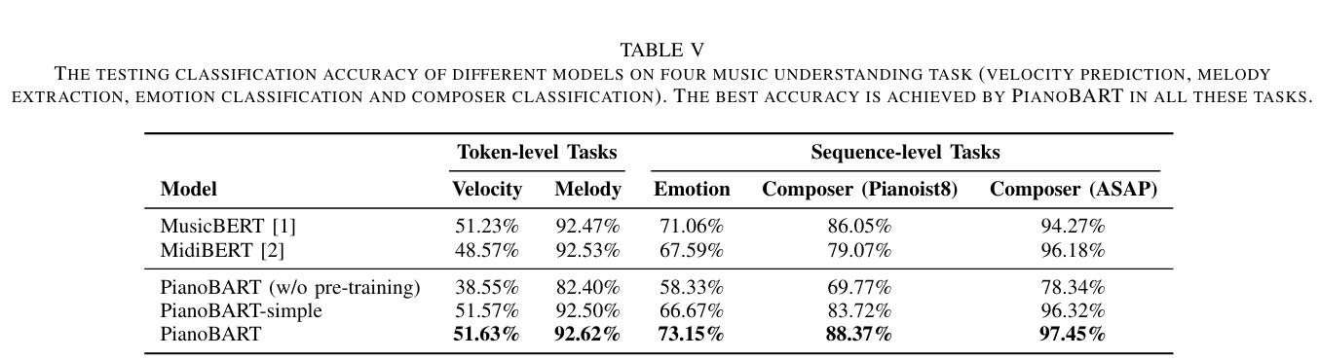
Experiment

Slide 17
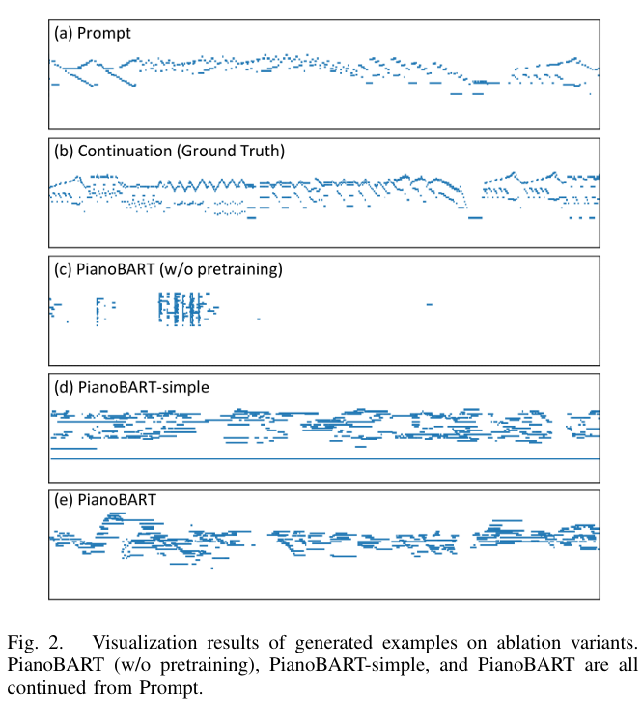

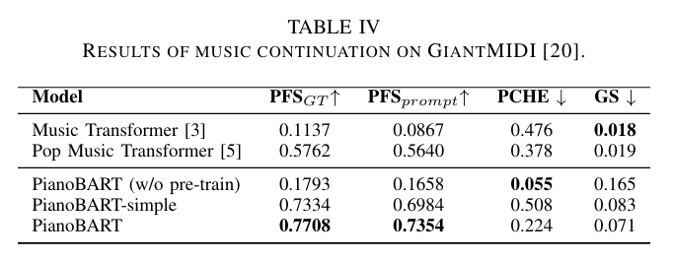
Experiment

Slide 18



Part IV: Stage Light Generation from Music
Skip-BART
[3] Zijian Zhao, Dian Jin, Zijing Zhou, Xiaoyu Zhang*, "Automatic Stage Lighting Control: Is it a Rule-Driven Process or a Generative Task?" (under anonymous review, available in AriXiv 2025)

Slide 19
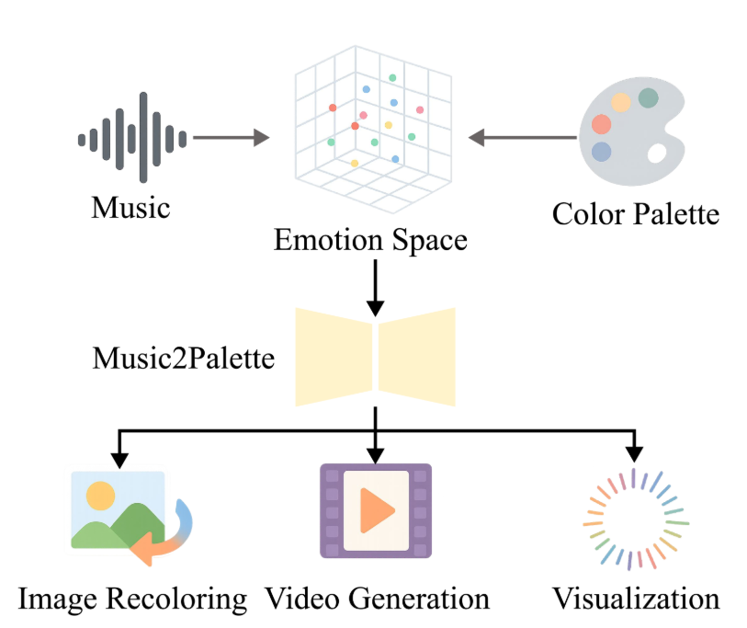
Previous Works
Rule-based Light Control
Emotion
Style
Topic
Lycris
Chord
......
Challenges & Shortcomings
Corse-grained Classification -- Can the model effectively distinguish between:
C, Cm, Csus4, C7, Cm7, C9, ...
Atmosphere Black Metal, Melodic Black Metal, Depressive Black Metal, Folk Black Metal, ....
Low Accuracy
The effectiveness of rule-based methods is heavily reliant on accurate classification.
Low Interpretability [12]
The rationale behind the mappings is often unclear.
[13]
Notes:
[12] McDonald J, Canazza S, Chmiel A, et al. Illuminating music: Impact of color hue for background lighting on emotional arousal in piano performance videos[J]. Frontiers in Psychology, 2022, 13: 828699.
[13] Hu J, He Y, Liang T, et al. Music2Palette: Emotion-aligned Color Palette Generation via Cross-Modal Representation Learning[J]. arXiv preprint arXiv:2507.04758, 2025.

Slide 20
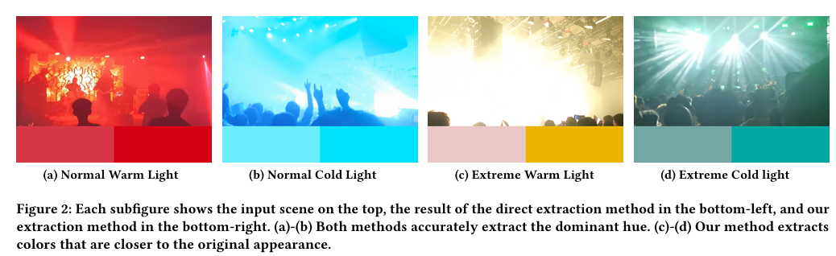
Code Link: https://github.com/RS2002/Skip-BART
Dataset Link: https://huggingface.co/datasets/RS2002/RPMC-L2
My Band Link: https://tokamak-disruption.netlify.app
Dataset & Data Process
End-to-End is all you need!
Dataset
Introducing the first stage lighting dataset: Rock, Punk, Metal, and Core - Livehouse Lighting (RPMC-L2).
Contains 699 videos collected from 2020 to 2024 in Guangzhou and Shenzhen.
To avoid copyright issues, only processed feature data is released.
Data Process
Extract hue and value for each frame from the Hue, Saturation, and Value (HSV) color space.

Slide 21
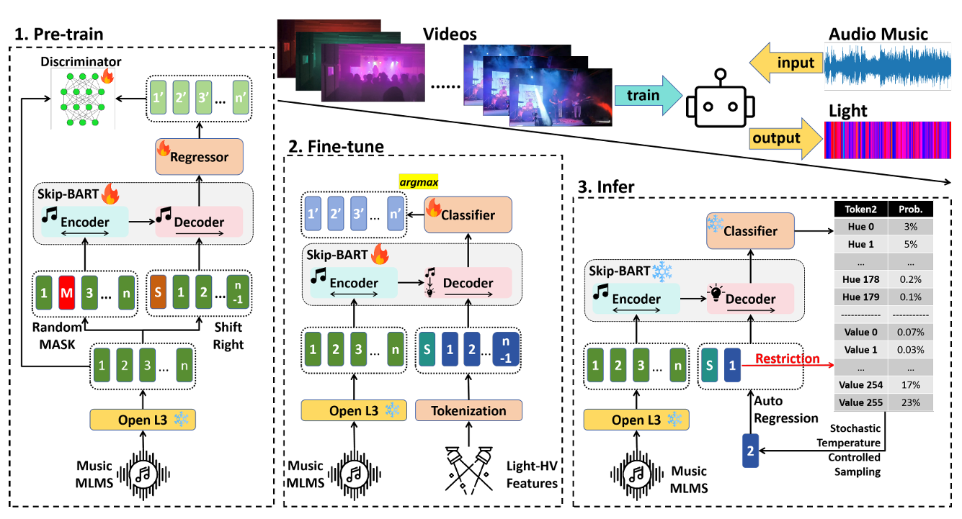
Workflow
Pre-training
pre-trained parameters from PianoBRT + music-only MLM pre-training
Fine-tuning
Inference
restricted stochastic temperature sampling

Slide 22
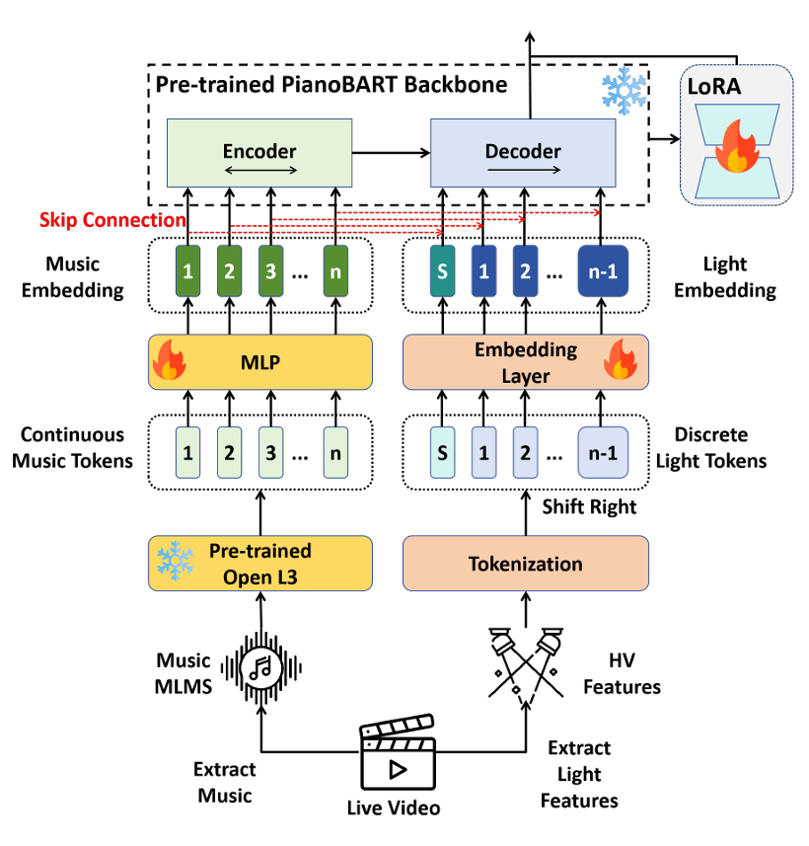
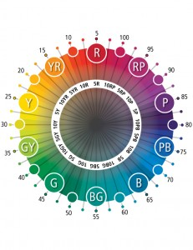
Model Structure
Music Embedding
OpenL3
Light Embedding
Discrete Embedding Layer
Why discretizing?
The Hue space is circular.
Skip-Connection Mechanism
Connect each frame of music and light before inputting to the decoder.
Backbone
Frozen PianoBART
Trainable LoRA

Slide 23
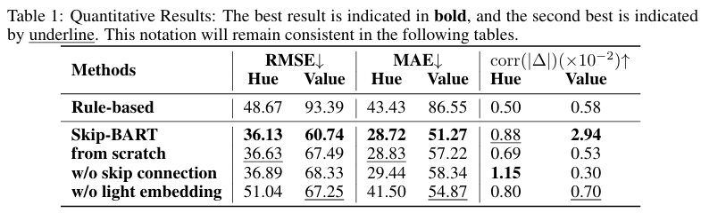
Quantitative Evaluation
Objects
Groun Truth
Rule-based Method (based on emotion-mapping)
Skip-BART
Ablation Study (Skip-BART w/o skip-connection)

Slide 24
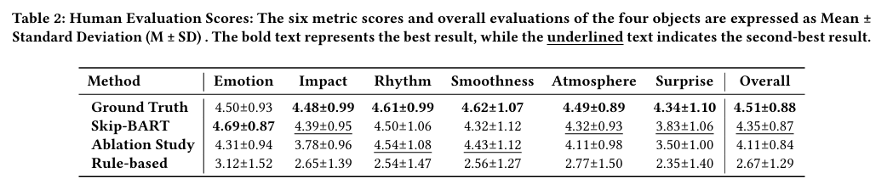
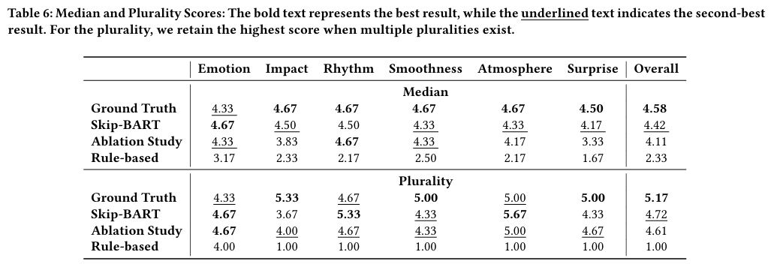
Human Evaluation

Slide 25
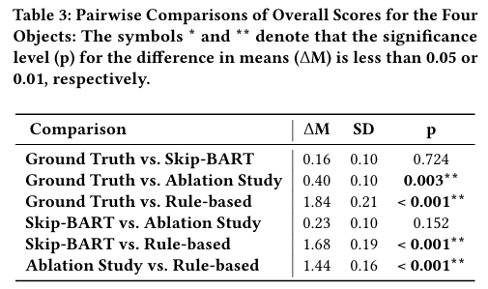
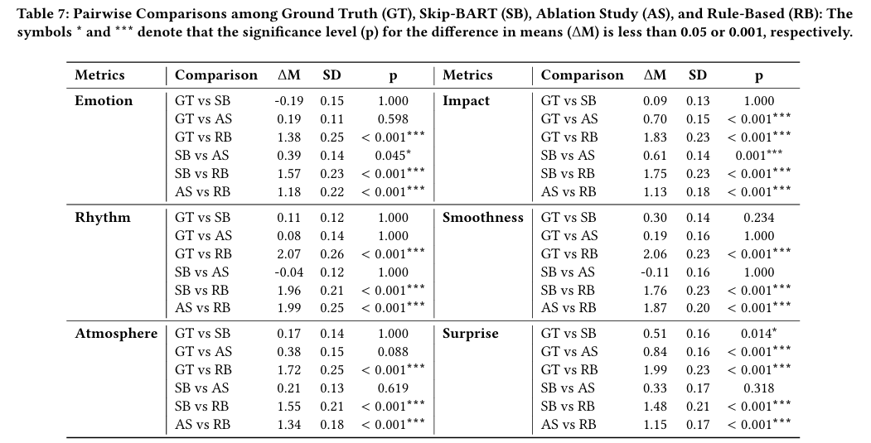
Human Evaluation
Our method yields a p-value of 0.724 in a statistical comparison based on human evaluations with human lighting engineers, suggesting that the proposed approach does not significantly differ from human lighting engineering performance.

Slide 26
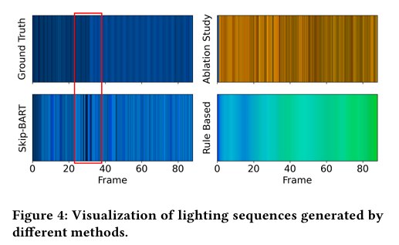
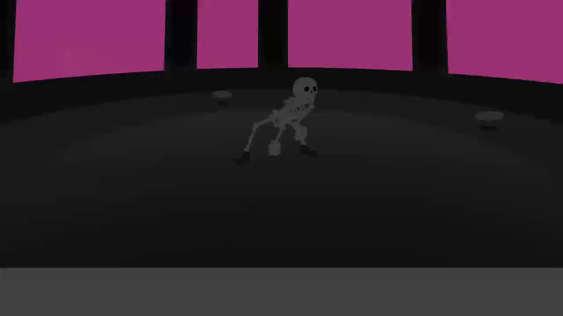
Visualization Result
align successfully

Slide 27
Part V: Music Generation from Iamge
A Multi-Modal RAG Assisted VLM Framework
[4] Zijian Zhao*, Dian Jin, Zijing Zhou, "Zero-Effort Image-to-Music Generation: An Interpretable RAG-based VLM Approach" (under way, to be submitted to IEEE Signal Processing Letters (SPL))

Slide 28
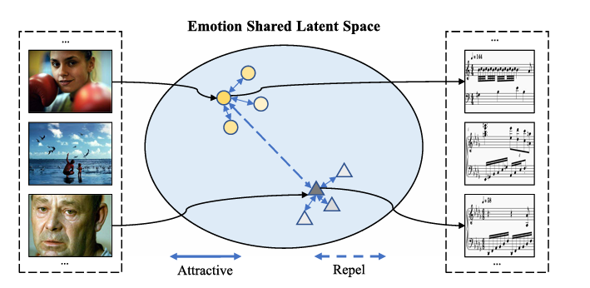
Previous Works
Training-Based Methods
Large Computation Resource Requirement
Dataset Limitations
Low Interpretability
Mapping-Based Methods
Lack of Rationality
Low Interpretability
Our Method
High Interpretability
Low Cost
No Need for Training
High Quality
RAG-Based Generation
Self-Refinement Mechanism
[14]
Notes:
[14] Wang Y, Chen M, Li X. Continuous emotion-based image-to-music generation[J]. IEEE Transactions on Multimedia, 2023, 26: 5670-5679.

Slide 29
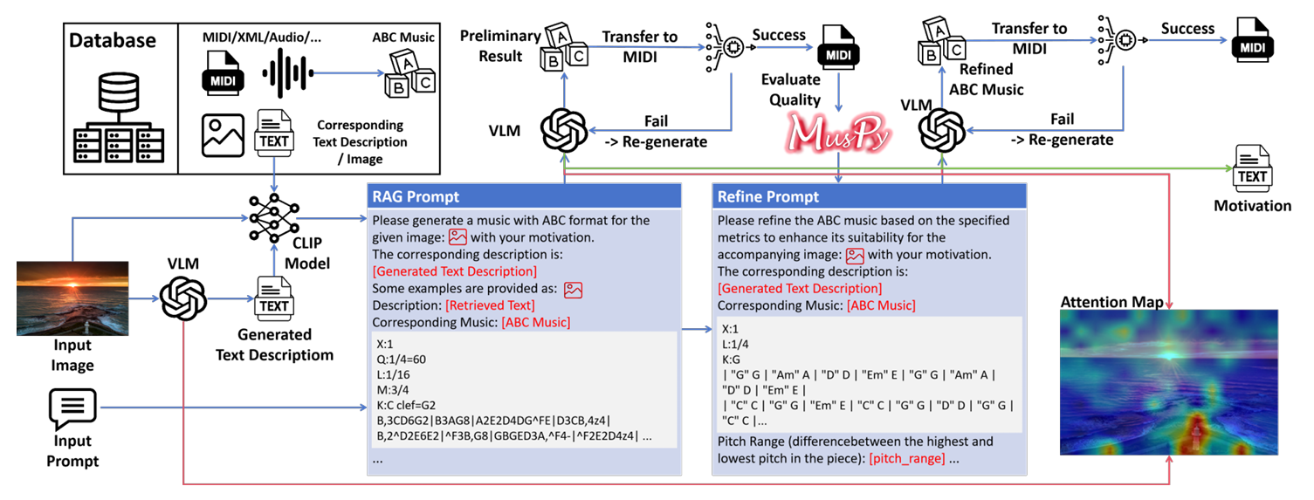
Workflow
Primary Music Generation
Generate Image Description
Generate ABC Music via Multi-Modal RAG
Music Refinement Using a Model-Based Evaluator
Self-Refine According to Music Quality Metrics
Explanation Generation with Text Output and Image Attention Map

Slide 30
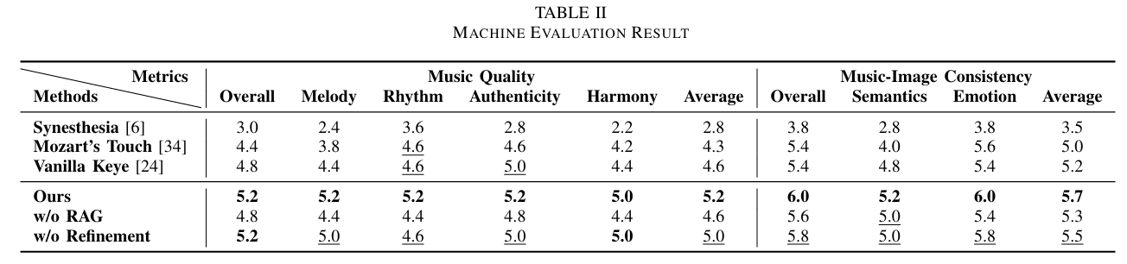
Machine Evaluation
LM as Judger
Generation VLM
Open Source SOTA: Keye-VL-8B [15]
Evaluation VLM
Latest Closed Source Model: Grok4 [16]
Notes:
[15] Team K K, Yang B, Wen B, et al. Kwai Keye-VL Technical Report[J]. arXiv preprint arXiv:2507.01949, 2025.
[16] xAI, “Grok.” [Online]. Available: https://grok.com/

Slide 31
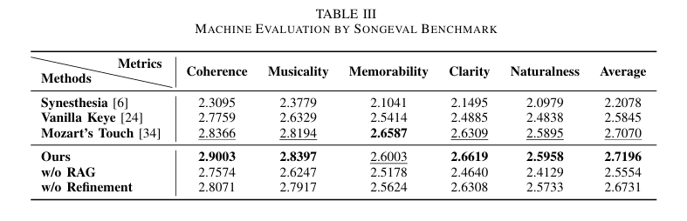
Machine Evaluation
Music Quality Evaluation
SongEval [17]
Notes:
[17] Yao J, Ma G, Xue H, et al. SongEval: A Benchmark Dataset for Song Aesthetics Evaluation[J]. arXiv preprint arXiv:2505.10793, 2025.

Slide 32
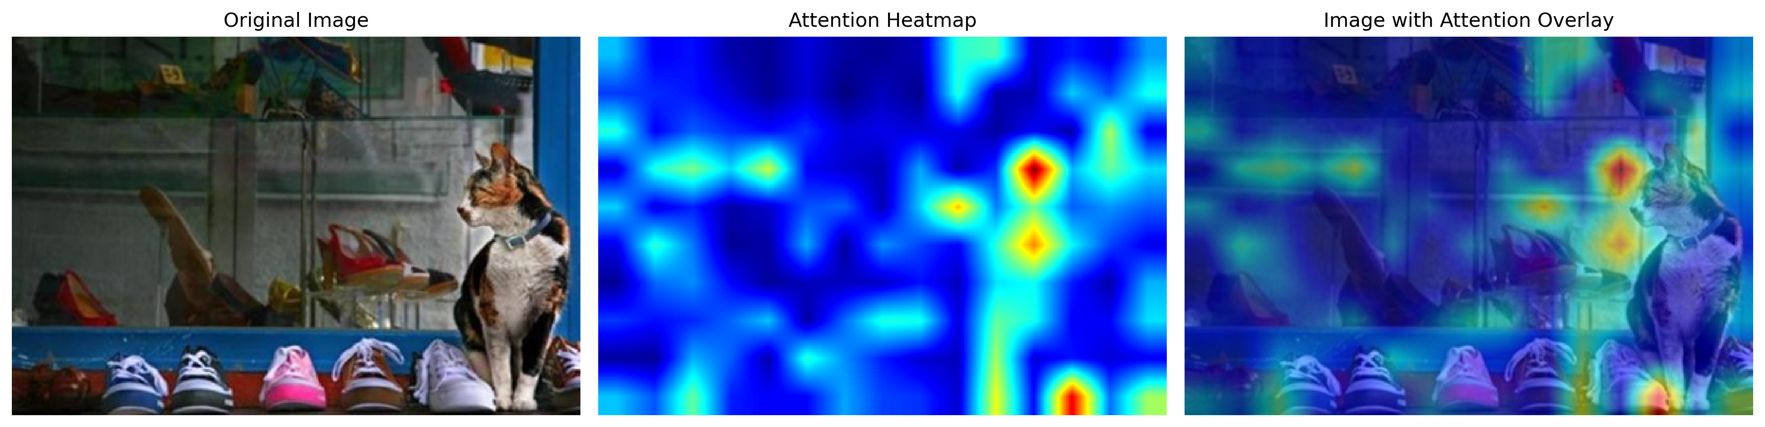
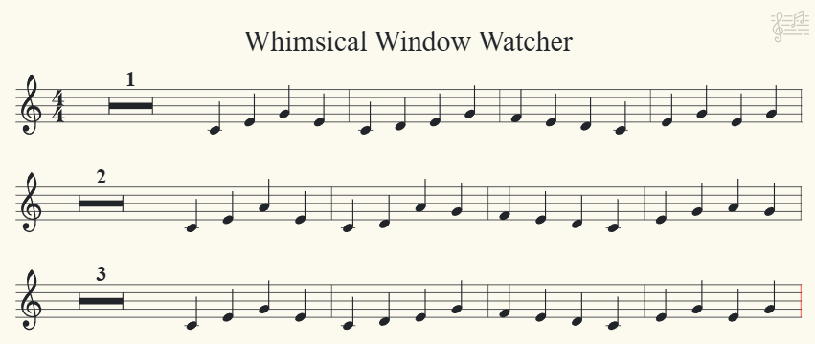
Generation Result
The music for "Whimsical Window Watcher" aims to evoke the serene curiosity of a calico cat observing a vibrant shoe display. The gentle 4/4 meter and C major key establish a calm, playful foundation, while the flowing melody (inspired by the cat’s graceful movements) weaves through the scene. Light dynamics (mf to crescendo) mirror the cat’s growing fascination, and simple ornaments (trills) add a whimsical touch, reflecting the vibrant yet peaceful atmosphere of the shop. The repeated motifs and soft resolution capture the cat’s lingering gaze, blending the tranquil interior with the lively colors of the shoes.

Slide 33
Thanks for your attention!
Presented by Zijian Zhao
Email: zzhaock@connect.ust.hk
Homepage: https://zijianzhao.netlify.app

